Slide 2
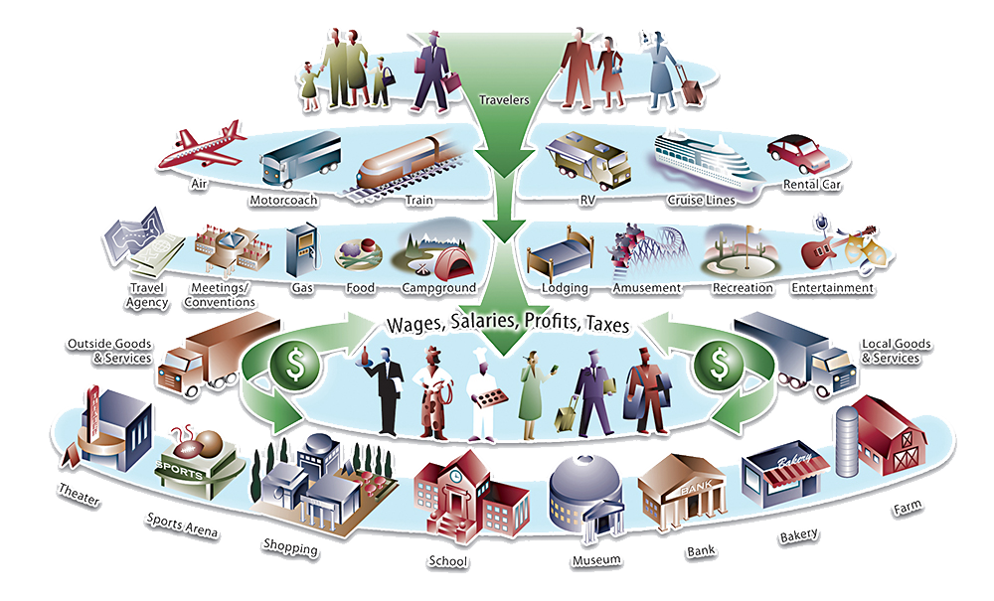
How Travel Dollars Support the Spokane Region
Source: USA Travel Association

Slide 3
Source: Dean Runyan

Slide 4
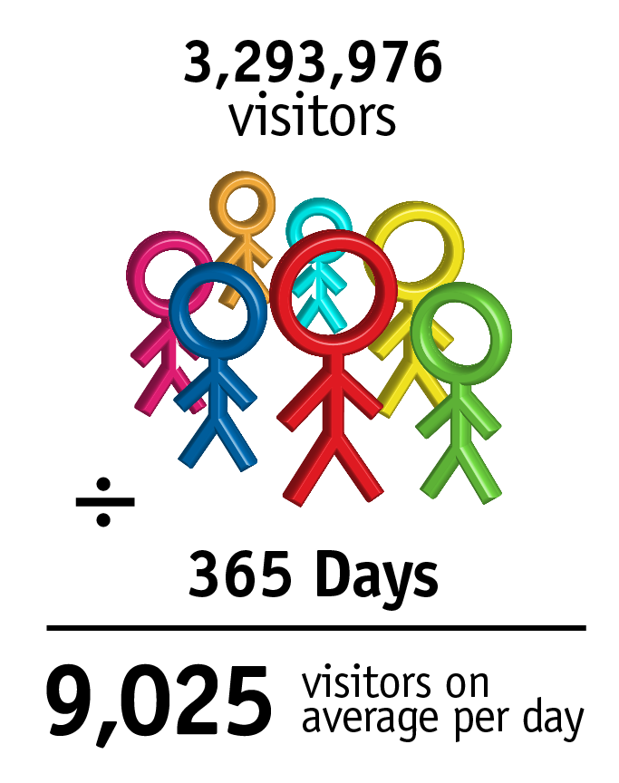
Travel in the Spokane Region
Source: Dean Runyan

